Slide 1

Indian Sign Language Character Recognition: A Computer Vision Based System
Ajith.J cse09405
K.S.Karthick cse09415
Niranjan.M cse09427
Saipreethy.M.S cse09443
Shangeetha.R.K cse09447
Valliammai.V cse09454
Amrita Vishwa Vidyapeetham, Coimbatore.

Slide 2
Problem Statement What are we trying to do?
Developing a real time system that accepts Indian Sign Language gestures as input through a webcam.
Processing the input using Image Processing techniques.
Outputting the character corresponding to the gesture in text format.

Slide 3
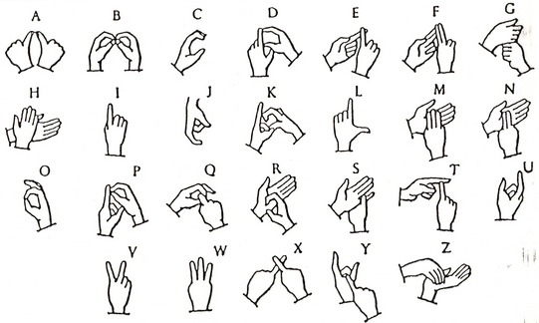
Indian Sign Language Characters

Slide 4
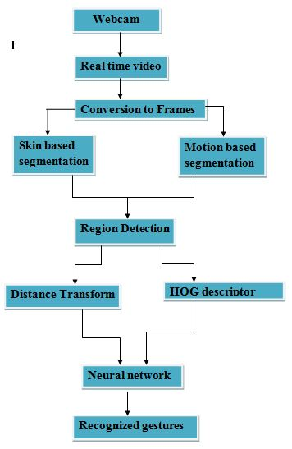
Architecture of the system

Slide 5
Segmentation

Slide 6
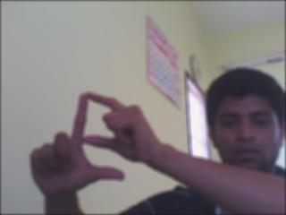
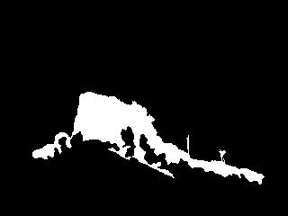
Skin color based segmentation
Hue Saturation and Intensity color model
25<H<230 and 25<S<230
Low complexity.
Very erratic detection.
Influence of brightness persisted.

Slide 7

Motion Based segmentation method
Most of ISL gestures involved some form of motion.
Detection was highly independent of illumination of environment.
But all moving objects in a frame were detected.
Simply assessing the background and subtracting current frame from background

Slide 8


Hybridization
Overlap the outputs of the skin and motion detection and take intersection.
With this illumination invariance and robust detection was achieved.

Slide 9
Feature Extraction

Slide 10
Single Handed Gestures

Slide 11
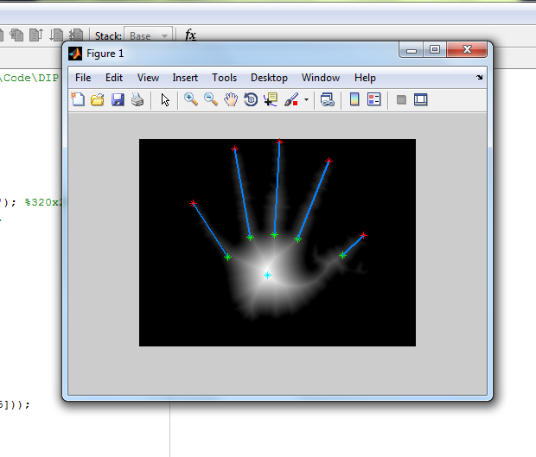
Distance Transform

Slide 12
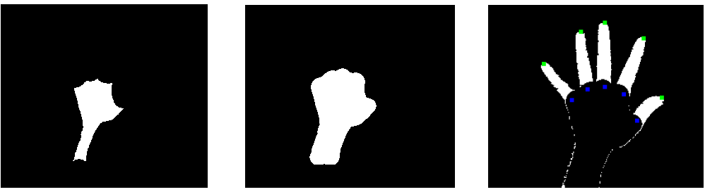
Identifying extent of closure and Angle between fingers
Erosion and Dilation using Structure element
(a) Erosion (b)Dilation (c)Subraction

Slide 13
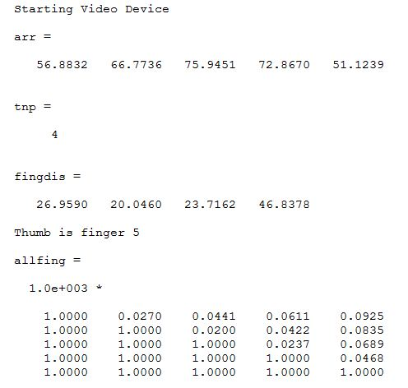

Feature extraction
An upper triangular matrix stores the distance between each finger with respect to every other finger is obtained.
The length of each finger is calculated and the average over 50 frames is stored.

Slide 14

Recognition phase
The distances from the last detected finger to all other fingers is calculated.
This is compared to the upper triangular matrix to find out which of the fingers are open.
The lengths of the fingers are then used to find if the fingers are full open or half open.

Slide 15

Recognition phase
The distances from the last detected finger to all other fingers is calculated.
This is compared to the upper triangular matrix to find out which of the fingers are open.
The lengths of the fingers are then used to find if the fingers are full open or half open.

Slide 16

Recognition phase
The distances from the last detected finger to all other fingers is calculated.
This is compared to the upper triangular matrix to find out which of the fingers are open.
The lengths of the fingers are then used to find if the fingers are full open or half open.
The angle between the open fingers is found
So the feature set size is 10

Slide 17
Two Handed Gestures

Slide 18
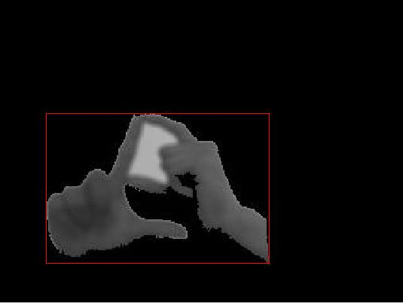

Pre-processing
Need to make sure the features are consistent for the same gesture performed by different people.
Extract the hand region using a bounding box.
Resize image to 90X90 pixels for uniformity.

Slide 19
Histogram of Orientation Gradients
A relatively new technique using primarily for object detection.(2005)
Computes the gradient direction and bins them to form a histogram of n bins.
It is done locally, i.e the image is divided into a number of dense cells and 2 filters are convolved with each cell.
X- gradient: [-1 , 0 , 1 ] and Y gradient: [-1 , 0 , 1]^{T}

Slide 20
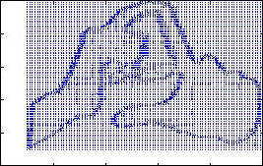
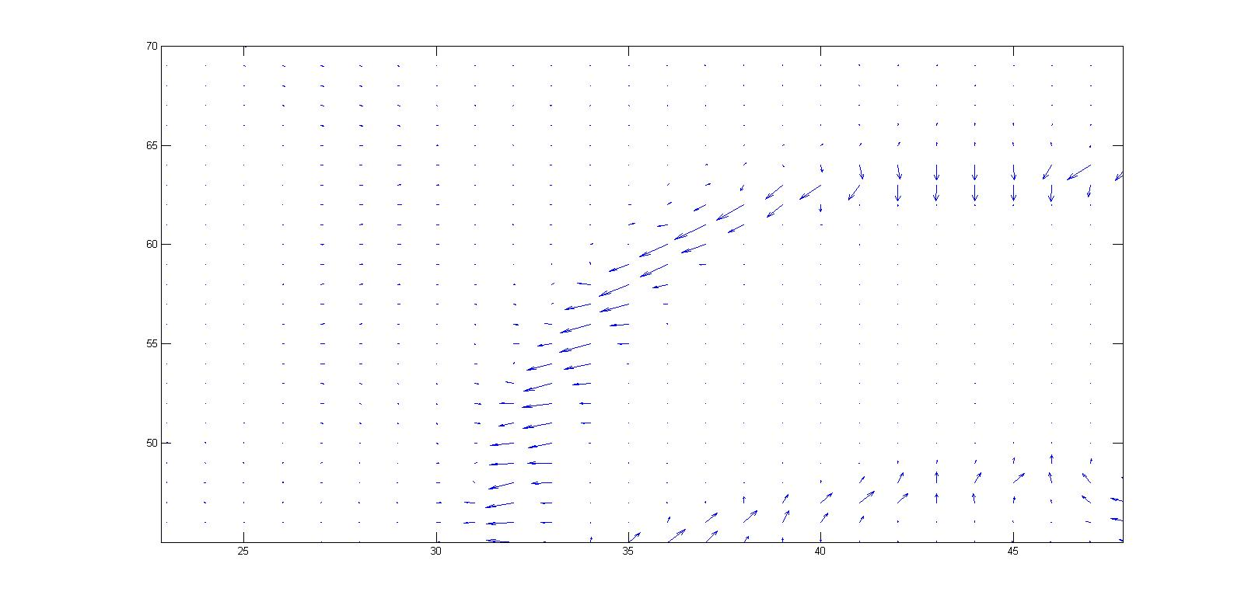
Histogram of Orientation Gradients
Resultant Magnitude:
Sqrt((y-grad)²+(x-grad)²)
Localized normalization of the gradient vectors.

Slide 21
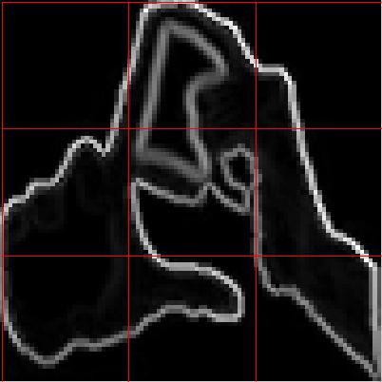

Our parameters
Number of Bins: 12.
Number of cells:3 x 3.
Each cell containing 30x30 pixels.
Final descriptor size: 9x12 unit vector.

Slide 22
Sample Feature Vector
A
B

Slide 23
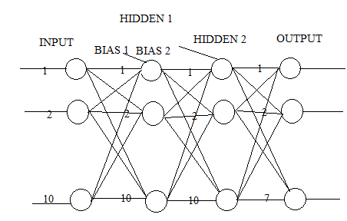
Neural Network
Neural Network- Single hand

Slide 24
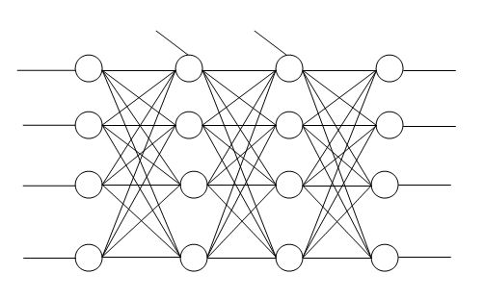
Initial Network Architecture- Two hand
Hidden layers
Input
Bias 1
Bias 2
Output
1
1
1
1
2
2
2
2
3
3
3
3
108
21
21
18

Slide 25
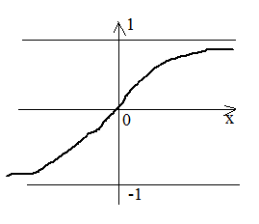
Transfer function- tansig
tansig function is the hyperbolic sigmoid transfer function.
Takes values from -1 to +1

Slide 26
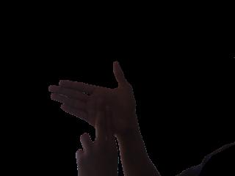
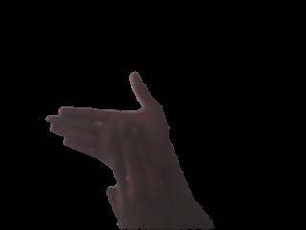

The problem
ISL characters had several ambiguities. Example: m and n, p and d.
When 20 characters where trained and tested using a single network recognition was erratic.

Slide 27
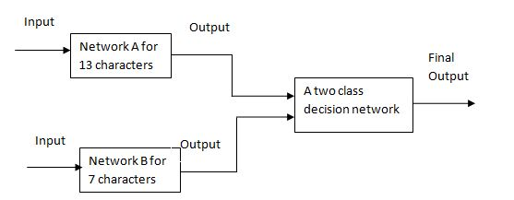
Multiple Network Architecture

Slide 28

Network Details
Two hand: Network A
2 hidden layers
108 input neurons
12output neurons
Two hand: Network B
2 hidden layers
108 input neurons
7 output neurons
Class A: a,b,d,g,h,m,o,p,r,t,x,z
Class B: e,f,k,n,q,s,y
Single hand:
2 Hidden layers.
10 input neurons.
7 output neurons

Slide 29
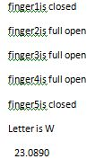
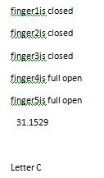
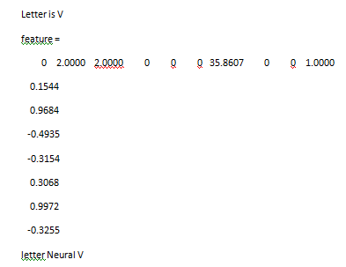
Results- Single hand
Output after training the customized neural network.

Slide 30
Confusion Matrix
Single handed Characters
 | L | C | I | U | V | W | Nothing
L | 100
C |  | 65 |  |  |  |  | 35
I | 4 | 3 | 72 | 2 | 3 |  | 16
U |  | 4 |  | 92 |  |  | 4
V |  |  |  |  | 87 | 13
W |  |  |  |  |  | 100
Nothing |  | 2 | 3 |  |  |  | 95

Slide 31
Accuracy Table
LETTER | COMPARISON METHOD ^{[14]} | FEED FORWARD | CASCADE FEED FORWARD | PROPOSED NEURAL NET
L | 80 | 97 | 95 | 100
C | 42 | 93 | 95 | 97
I | 88 | 100 | 100 | 100
U | 60 | 87 | 82 | 96
W | 71 | 100 | 100 | 100
V | 85 | 100 | 100 | 100
Nothing | 72 | 100 | 100 | 100

Slide 32


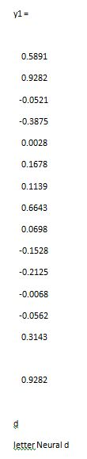
Results- Two hand
After training the HOG features of the characters

Slide 33
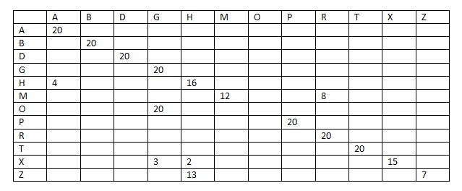
Confusion Matrix-Class A
2 handed characters Class A- Magnitude Binning without Thresholding

Slide 34
Confusion Matrix-Class B
2 handed characters Class B- Magnitude Binning without Thresholding
 | E | F | K | N | Q | S | Y
E | 20
F | 2 | 18
K |  | 2 | 18
N |  | 2 |  | 18
Q |  | 5 |  |  | 15
S |  |  |  |  |  | 20
Y |  |  |  |  |  |  | 20

Slide 35
Combining the two classes A and B

Slide 36
Different Network Architectures
Number of neurons in Hidden layer 1 | Number of neurons in Hidden layer 2
36 | 21
45 | 21
52 | 35
52 | 45
58 | 21

Slide 37
Network Architecture
Hidden layers
Input
Bias 1
Bias 2
Output
1
1
1
1
2
2
2
2
3
3
3
3
108
36
21
18

Slide 38
Confusion matrix
 | A | B | D | G | M | Z | H | P | R | X | Y | E | F | N | K | S | Q | T
A | 20
B |  | 20
D |  |  | 20
G |  |  |  | 20
M |  |  |  |  | 15 |  |  |  |  |  |  |  |  |  |  | 5
Z |  |  |  |  |  | 20
H |  |  |  |  |  |  | 20
P |  |  | 5 |  |  |  |  | 15
R |  |  |  |  | 12 |  |  |  |  |  |  |  |  | 8
X |  |  |  |  |  |  |  |  |  | 20
Y | 7 |  |  |  |  |  |  |  |  | 5 |  |  |  |  |  |  | 8
E |  |  |  |  |  |  |  |  |  | 20
F |  |  |  |  |  |  |  |  |  | 20
N |  |  |  |  | 20
K |  |  | 20
S |  |  |  |  |  |  |  |  |  |  |  |  |  |  |  | 20
Q |  | 10 |  |  |  |  |  |  |  |  | 10
T |  |  |  |  |  |  |  |  |  |  |  |  |  |  |  |  |  | 20

Slide 39
Network Architecture
Hidden layers
Input
Bias 1
Bias 2
Output
1
1
1
1
2
2
2
2
3
3
3
3
108
45
21
18

Slide 40
Confusion matrix
 | A | B | D | G | M | Z | H | P | R | X | Y | E | F | N | K | S | Q | T
A | 20
B |  | 20
D |  |  | 20
G |  |  |  | 20
M |  |  |  |  | 8 |  |  |  |  |  |  |  |  | 7 |  | 5
Z | 20
H |  |  |  |  |  |  | 20
P |  |  | 5 |  |  |  |  | 15
R |  |  |  |  | 14 |  |  |  |  |  |  |  |  | 6
X |  |  |  |  |  |  |  |  |  |  |  | 9 |  |  |  |  |  | 11
Y | 7 |  |  |  |  |  |  |  |  | 5 |  |  |  |  |  |  | 8
E |  |  |  |  |  |  |  |  |  | 20
F |  |  |  |  |  |  |  |  |  | 12 |  | 8
N |  |  |  |  | 20
K |  |  | 20
S |  |  |  |  |  |  |  |  |  |  |  |  |  |  |  | 20
Q |  | 10 |  |  |  |  |  |  |  |  | 10
T |  |  |  |  |  |  |  |  |  |  |  |  |  |  |  |  |  | 20

Slide 41
Network Architecture
Hidden layers
Input
Bias 1
Bias 2
Output
1
1
1
1
2
2
2
2
3
3
3
3
108
52
35
18

Slide 42
Confusion matrix
 | A | B | D | G | M | Z | H | P | R | X | Y | E | F | N | K | S | Q | T
A | 20
B |  | 20
D |  |  | 20
G |  |  |  | 20
M |  |  |  |  | 20
Z | 17 |  |  |  |  |  | 3
H |  |  |  |  |  |  | 20
P |  |  | 5 |  |  |  |  | 15
R |  |  |  |  | 12 |  |  |  |  |  |  |  |  | 8
X |  |  |  |  |  |  |  |  |  | 13 |  |  | 7
Y | 2 |  |  |  |  |  |  |  |  | 9 |  |  |  |  |  |  | 9
E |  |  |  |  |  |  |  |  |  | 20
F |  |  |  |  |  |  |  |  |  |  |  |  | 20
N |  |  |  |  | 20
K |  |  | 20
S |  |  |  |  |  |  |  |  |  |  |  |  |  |  |  | 20
Q |  | 14 |  |  |  |  |  |  |  |  | 6
T |  |  |  |  |  |  |  |  |  |  |  |  |  |  |  |  |  | 20

Slide 43
Network Architecture
Hidden layers
Input
Bias 1
Bias 2
Output
1
1
1
1
2
2
2
2
3
3
3
3
108
52
45
18

Slide 44
Confusion matrix
 | A | B | D | G | M | Z | H | P | R | X | Y | E | F | N | K | S | Q | T
A | 20
B |  | 20
D |  |  | 20
G |  |  |  | 20
M |  |  |  |  | 20
Z |  |  |  |  |  | 14 | 6
H |  |  |  |  |  |  | 20
P |  |  | 2 |  |  |  |  | 18
R |  |  |  |  |  |  |  |  |  |  |  |  |  |  |  | 20
X |  |  |  |  |  |  |  |  |  | 20
Y |  |  |  |  | 12 | 8
E |  |  |  |  |  |  |  |  |  | 20
F |  |  |  |  |  |  |  |  |  | 20
N |  |  |  |  | 10 |  |  |  |  |  |  |  |  |  |  | 10
K |  |  |  |  |  |  |  |  |  |  |  |  |  |  | 20
S |  |  |  |  |  |  |  |  |  |  |  |  |  |  |  | 20
Q |  | 5 |  |  |  |  |  |  |  |  | 15
T |  |  |  |  |  |  |  |  |  |  |  |  |  |  |  |  |  | 20

Slide 45
Finalized Network Architecture
Hidden layers
Input
Bias 1
Bias 2
Output
1
1
1
1
2
2
2
2
3
3
3
3
108
58
21
18

Slide 46
Reduced Number of Decision Networks
Decision networks implemented only for confusing alphabets.
This minimizes the training complexity and the overall complexity of the system
Decision Network 1: X,E,F
Decision Network 2: H,G,Y,Z
Decision Network 3: R,M,N,S

Slide 47
Confusion Matrix for the finalized system
 | A | B | D | G | M | Z | H | P | R | X | Y | E | F | N | K | S | Q | T
A | 20
B |  | 20
D |  |  | 20
G |  |  |  | 20
M |  |  |  |  | 19
Z |  |  |  |  |  | 15 |  |  |  |  | 5
H |  |  |  |  |  |  | 20
P |  |  |  |  |  |  |  | 20
R |  |  |  |  | 4 |  |  |  | 16
X |  |  |  |  |  |  |  |  |  | 20
Y |  |  |  |  |  | 2 |  |  |  |  | 18 |  |  |  |  |  | 8
E |  |  |  |  |  |  |  |  |  | 3 |  | 17
F |  |  |  |  |  |  |  |  |  | 4 |  |  | 16
N |  |  |  |  |  |  |  |  |  |  |  |  |  | 20
K |  |  |  |  |  |  |  |  |  |  |  |  |  |  | 20
S |  |  |  |  |  |  |  |  |  |  |  |  |  |  |  | 20
Q |  | 10 |  |  |  |  |  |  |  |  |  |  |  |  |  |  | 10
T |  |  |  |  |  |  |  |  |  |  |  |  |  |  |  |  |  | 20

Slide 48
Training and Testing Details
Samples taken from 2 people used for training the networks
Tested for 10 different people.
50 frames each

Slide 49
Accolades
Presented a paper at the International Conference in Machine Vision and Image Processing at PSG Tech.
Second place- Paper presentation at Vidyut 2013.
Second Runner up- IBM ICARE 2012.
Winner- Paper presentation in Abacus 2013 held at Anna University Chennai.
Winner- Paper presentation in CSI National Convention 2013 at Amrita.
Submitted a paper for the journal- IJRCS. Awaiting acceptance.
Preparing a paper for submission in the International Journal for Signal, Video and Image Processing- Springer.

Slide 50
Conclusion
Identification of optimal features(bins).
ISL has a vast vocabulary that includes gestures for almost 3000 words.
These words involves more than just hands.

Slide 51
Thank You.

